Slide 1

Making Sense of Client Data:
Utility Usage of Multi-Family Housing in the United States
Group 5 - Project 3
Kirsten Rain, Mark Waananen, Mike Wellnitz,
Crystal Rosenbrook, Navyasri Pusuluri
​

Slide 2
What is the project?
This is a client facing deliverable for a company who provides utility and energy consulting and bill-pay services. The client used for our demo is in multi-family housing. Their energy bills around $2 million per month spread over thousands of accounts and hundreds of the locations. They need easy visual access to their data for decision making.​
Why did we want to do it?
The motivation behind this project was to see if we could replace an outdated platform for less time and money than a million dollar development team. And we did!​

Slide 3
The need:
Why the business is more complicated than it seems…
Million dollar bills
$50,000 late fees
15 day disconnects
3rd-party supply
Foreign currency
Unit conversions
100s of locations per client
1000s of accounts per month
$100,000 tax rebates
Rate audits
Conservation projects
Energy intensity (per sq ft)
Solar garden subscriptions
"Green Certification"
Ownership changes
Accounting codes
Multiple meters per acct.
Water benchmarking (per bdrm)

Slide 4
The data:
Why the data is more complicated than it seems…
Water
Sewer
Storm Water
Fire Protection
Irrigation
Recycled Water
Electric
Electric Supply
Electric Transport
Protective Lighting
Solar Generation
Solar Credits
Gas
Gas Supply
Gas Transport
Propane
Fuel Oil
Units of Measure (consumption)
Some utility types have a a unit of consumption that is recorded, but not counted.
Some utility types don't have any measured consumption, but need to get counted.
Having zeros in the data that needed to remain made the data wrangling and the math really hard.
Finding rates on grouped data was challenging (averaging averages fallacy).

Slide 5
Purpose:
The purpose of our project was to take an actual business scenario to help analyze electric, gas and water consumption at their apartment complexes across the country. They aimed to address the following:
What are the trend in consumption over time and can I spot out-of-normal usage?
What locations have the highest cost and what portion of the energy budget is going to each of those three utility types?
How do I identify the locations which will give the most impact for conservation or rate reduction efforts?

Slide 6
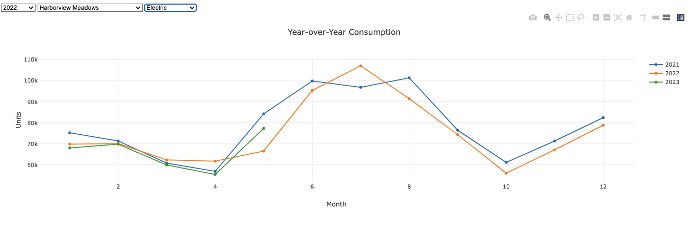
This graph shows consistent usage year over year. It is normal for electric consumption go up during the summer due to air conditioning.

Slide 7
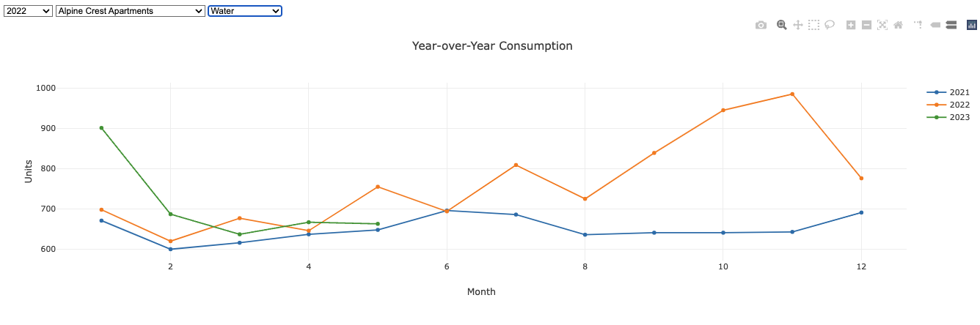
This graph shows a location that had a water leak over the winter that was found and fixed and you can see the usage trend back to normal values.

Slide 8
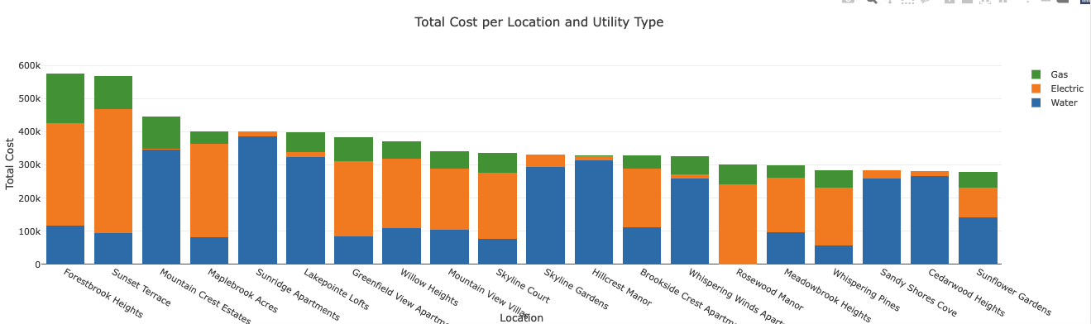
We included a stacked bar graph filtered for the most expensive locations and arranged descending. This visual is controlled by the year drop down. There is also a feature that gives the values for each of the three types on hover. The variation in utility measurements is due to geography/climate, housing complex configuration, and which bills the tenants pay. This bar graph helps the client identify where most of their money is going by utility type.

Slide 9
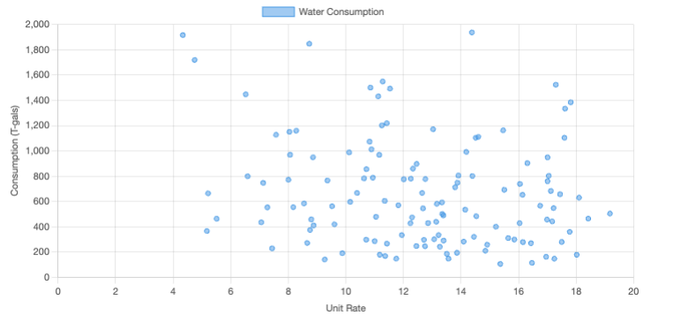
The next visual pertains only to water.
Water is important to the business for a few reasons:
Gas and Electricity don’t leak so you don’t have to monitor them like you have to for water.
In the multi-family sector, water is often the greatest expense because the tenants pay gas and electricity, but the building owner is required to pay the water.
There is also a lot of social/political pressure around water conservation right now.
This scatterplot is unit cost versus consumption. The unit rate for water averages $10 per thousand gallons (T-gal) but it can be as high as $20/T-gal. The client wants to focus their efforts on locations with high unit cost and high consumption (upper right).

Slide 10
Other questions not yet answered and ideas for visuals:
Does the unit cost vary by geography? We would have liked to do a map with unit rate as the dot size. Unfortunately when we de-identified the data, we only kept the zip code for each location and it would require more steps (and time and different API) to map it.
Is each location meeting their consumption per bedroom count benchmark? This is an important question for the client, but for this project it would just be another bar and line graph so we didn’t prioritize it.
How much is spent on stormwater? Clients pay many tens of thousands of dollars per month on stormwater fees that are based on blacktop square footage and this cost can be mitigated with rain gardens. Unfortunately, due to the unexpected aggravation and complexity of our 150,000 rows of data we removed storm water. It doesn’t have a unit of measure so it would have really muddied our results. We are still interested in this, perhaps another time. If there are any entrepreneurs here, start a rain garden business for companies with big parking lots!
Feel free to review how we constructed our dashboard:
https://mikewellnitz.github.io/Project_3/

